Slide 1
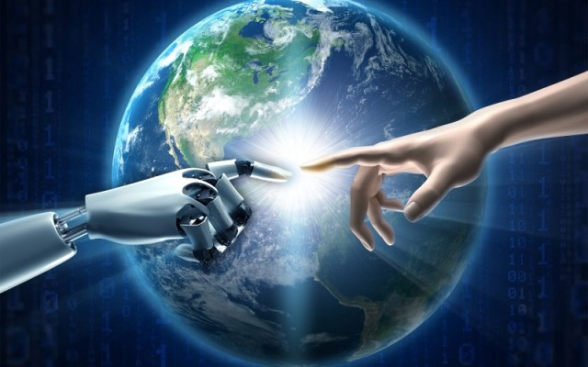
WILL AI BENEFIT US OR HARM US ?
Technology is advancing at an unprecedented rate and some expert predict that this rate is only going to increase with AI been at the forefront of innovation. But when ever the topic of AI comes about, there are often debates on whether this technology will benefit humans or harm us.

Slide 2
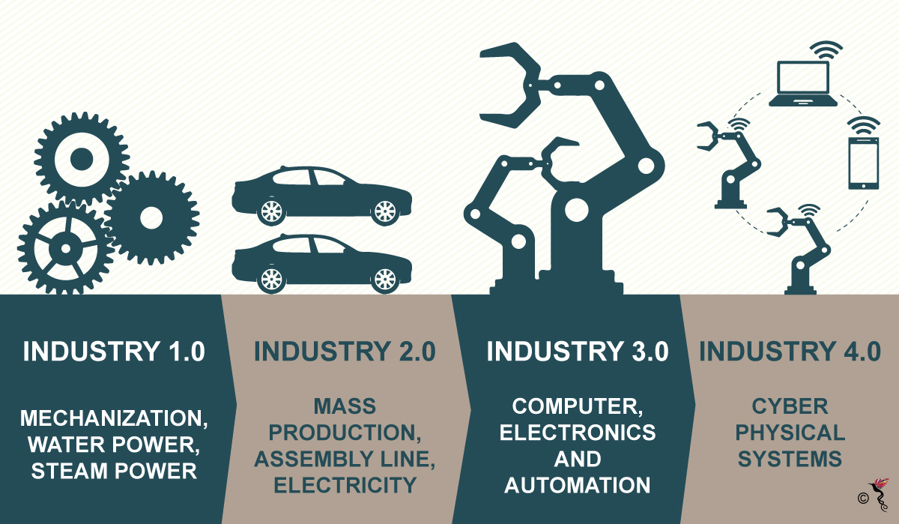
FOURTH INDUSTRIAL REVOLUTION NOT ENTIRELY A REVOLUTIONARY CONCEPT
The First Industrial Revolution kicked in somewhere around the 1760s when the steam engine was invented.
The steam engine gave rise to mechanical machines which could replace dozens of people. This led to a completely new way of manufacturing goods, where commodities were made in bulk in factories.
Steam trains gave rise to railroads that carried massive amounts of goods far more quickly and efficiently than ever conceivable by animal power.
This method was perfected by Henry Ford, who was able to shrink the time taken to produce a Model T car from 12 hours to just 93 minutes.

Slide 3
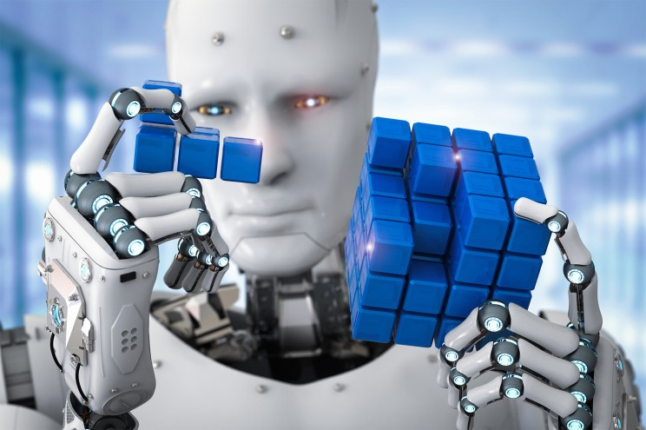
COULD AI TURN ROGUE ?
We need to be optimistic of the future, but not naively and recklessly. AI is a relatively new field, and we know very little about its true potential. No one can accurately predict what it will be capable of. There’s a very real danger it could outsmart us and even spiral out of control. Some of the most respected leaders of science and industry, most notably, the late Stephen Hawking, expressed concerns that super-intelligent machines could pose a long-term threat to humanity itself.

Slide 4
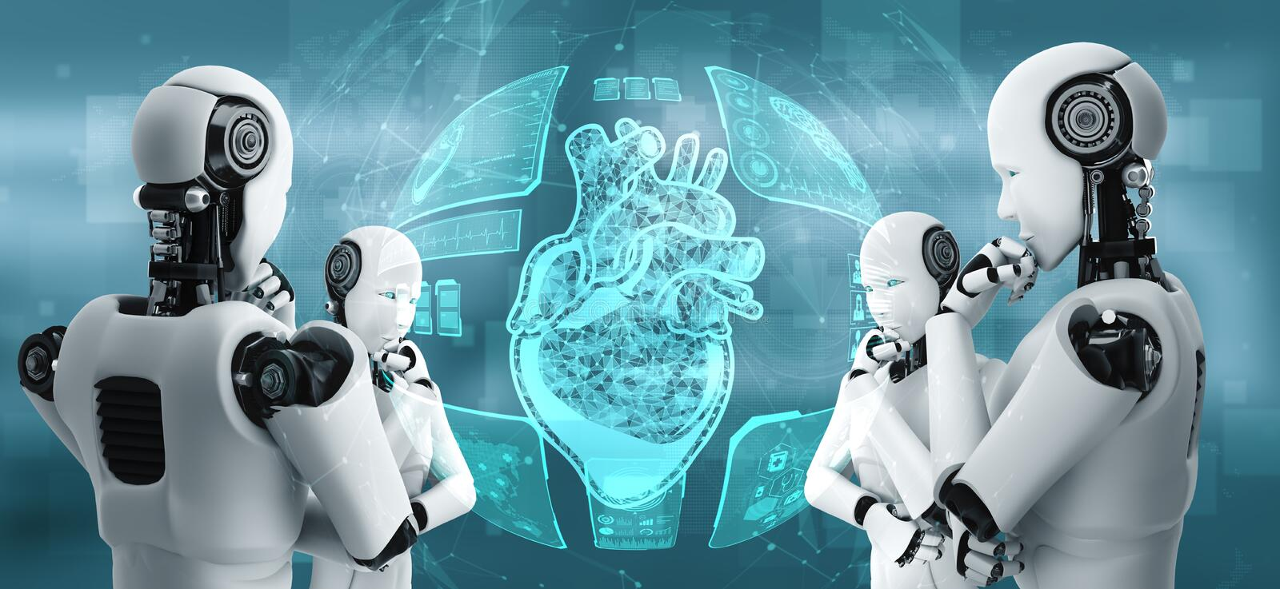
COMPUTERS MAKE GIANT LEAP
Making computers think like humans is undeniably the next frontier that scientists and engineers are to trying to reach.
However, machine learning, a field of computer science that programs computers with the ability to learn from data and make informed, adaptive, dynamic predictions, is currently reinventing the wheel in engineering industries.
In the last decade, technology has taken a gigantic leap forward. Machine learning has empowered these technologies, and today we have virtual assistants, speech recognition, incredible consumer products, and more.
Governments around the world are now trying their best to out-AI other governments. And that’s a good thing for future engineers.

Slide 5
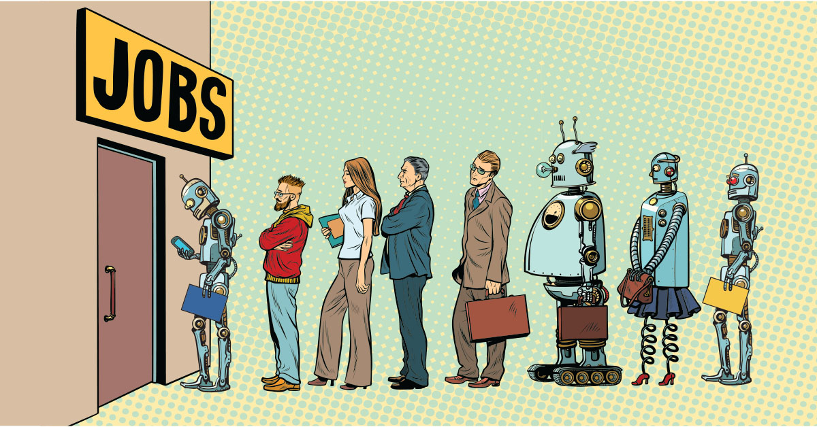
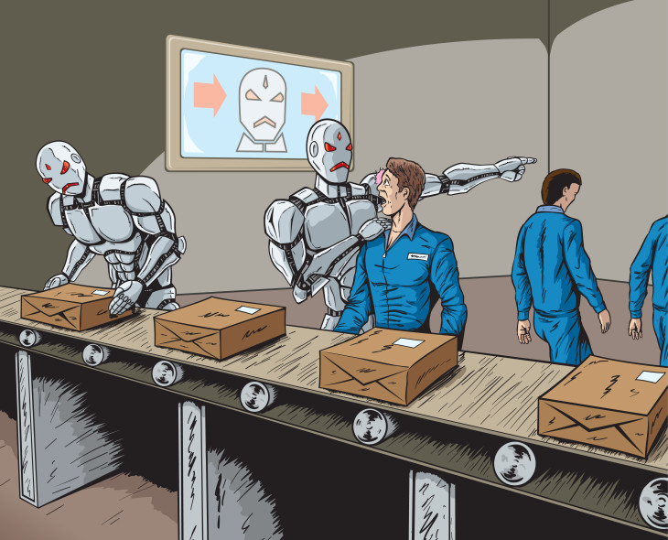
CAN WE BLAME TECHNOLOGY FOR PEOPLE’S JOB LOSS ?
Technological unemployment is the loss of jobs caused by technological change. It is a key type of structural unemployment.
Technological change typically includes the introduction of labour-saving "mechanical-muscle" machines or more efficient "mechanical-mind" processes (automation), and humans' role in these processes are minimized.^{[1]} Just as horses were gradually made obsolete as transport by the automobile and as labourer by the tractor, humans' jobs have also been affected throughout modern history. Historical examples include artisan weavers reduced to poverty after the introduction of mechanized looms. During World War II, Alan Turing's Bombe machine compressed and decoded thousands of man-years worth of encrypted data in a matter of hours. A contemporary example of technological unemployment is the displacement of retail cashiers by self-service tills and cashierless stores.

